Slide 1
Motors
Phil Baldwin
10/11/2019

Slide 2
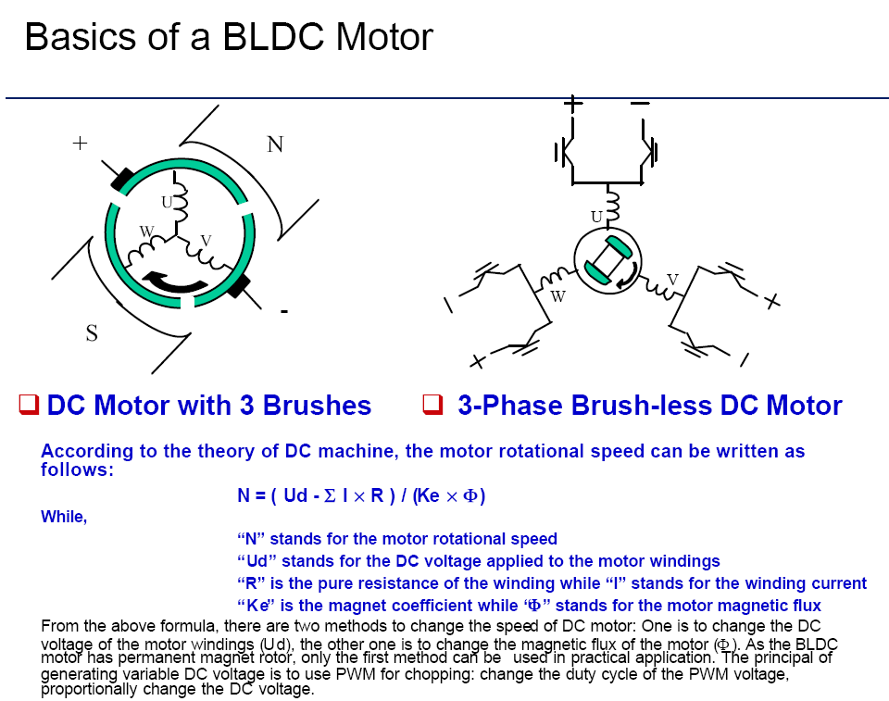
Approximate Motor Model

Slide 3
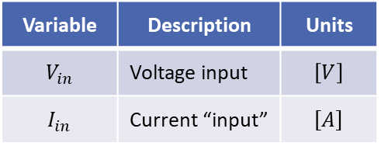
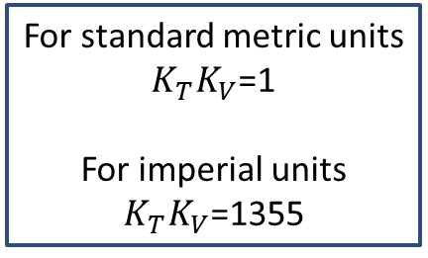
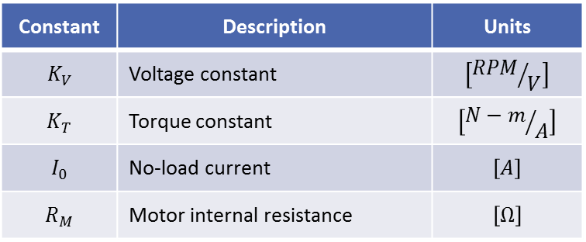
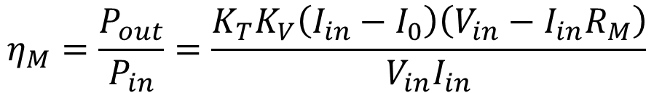
DC Motor Equations
$$Torque=Q_{MS}=K_{T}(I_{in}−I_{O})$$
$$RPM=60n=K_{V}(V_{in}−I_{in}R_{M})$$
For standard metric units
$K_{T}K_{V}$=1
For imperial units
$K_{T}K_{V}$=1355
Motor Specified
By 3 constants
Constant | Description | Units
$$K_{V}$$ | Voltage constant | $$\left[{RPM}/V\right]$$
$$K_{T}$$ | Torque constant | $$\left[{N−m}/A\right]$$
$$I_{0}$$ | No-load current | $$\left[A\right]$$
$$R_{M}$$ | Motor internal resistance | $$\left[Ω\right]$$
Variable | Description | Units
$$V_{in}$$ | Voltage input | $$\left[V\right]$$
$$I_{in}$$ | Current “input” | $$\left[A\right]$$
The motor efficiency is given by:
$$η_{M}=\frac{P_{out}}{P_{in}}=\frac{K_{T}K_{V}\left(I_{in}−I_{0}\right)\left(V_{in}−I_{in}R_{M}\right)}{V_{in}I_{in}}$$

Slide 4
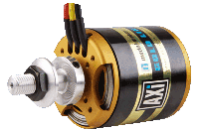
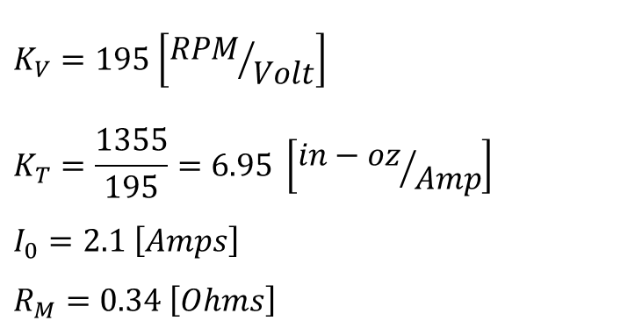
AXI 5345/16 HD
3-phase AC synchronous brushless motor with neodymium magnets and a rotating case (outrunner)
The outrunner has higher torque than “inrunner” motors, which means that the "outrunners" are able to drive larger and more efficient propellers without the need of gearboxes
$$K_{V}=195 \left[{RPM}/{Volt}\right]$$
$$K_{T}=\frac{1355}{195}=6.95 \left[{in−oz}/{Amp}\right]$$
$$I_{0}=2.1 \left[Amps\right]$$
$$R_{M}=0.34 \left[Ohms\right]$$

Slide 5
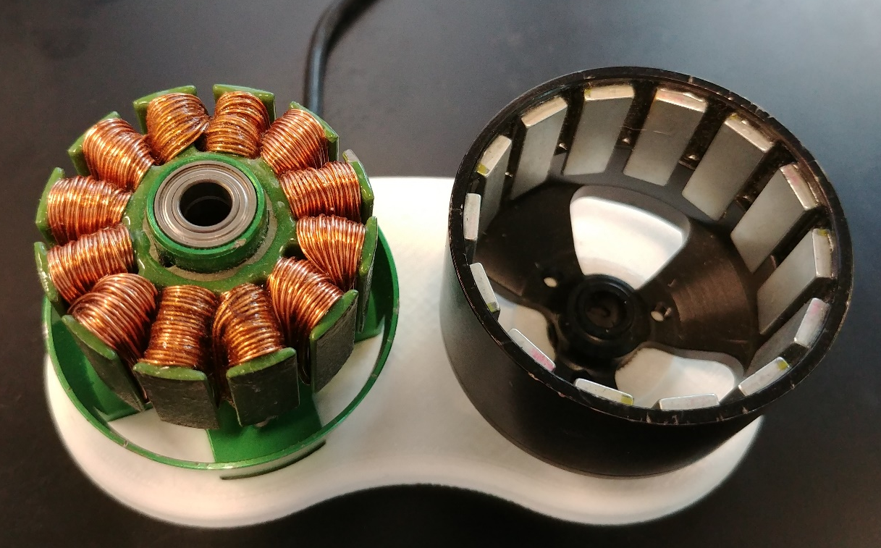
Inside a BLDC outrunner
Stator
Rotor
Shaft bearing (Shaft not present)
Laminations
Windings. Always a number divisible by 3.
Permanent magnets,
Referred to as poles. Alternate North/South.

Slide 6
System Setup
Prop
Control signal (From Rx, PixHawk)
DC
3φ AC
Battery
Motor
ESC
Power Connector
XT60/XT90 or Deans
Motor Connectors
Bullet connectors of varying diameters dependent upon current draw

Slide 7
Practical Considerations - Motors
The electric motor’s natural predator is heat
Pulling too much current leads to more heat in the windings, which leads to dead motors
NEVER TRY TO CONNECT A BATTERY DIRECTLY TO A BRUSHLESS MOTOR
That is how I the example piece from a few slides ago came to be
Many times a manufacturer will have a family of motors with similar characteristics
Example: Hacker A40 motors come in a variety of sub-models where the “can” diameter is the same, but the length of the laminations in the motor is longer in one than the other, meaning more torque and lower K_{V}
If your motor is rotating the wrong direction…
Unplug the battery, then swap any two of the three motor leads

Slide 8
Practical Considerations – System Compatibility
Batteries are rated by “C” rating – this is a multiplier, not a current
Example: Suppose a 5,000 mAh (5Ah) battery has a 20C constant discharge rating → 100 Amps maximum constant discharge
ESCs have a voltage window and a maximum continuous current
Make sure your battery voltage falls within the window (sometimes reported in cell count, e.g. 2S-4S LiPo)
Make sure you will not pull more current that the ESC can provide
Motors have a voltage window, a maximum continuous current, and a maximum continuous power (Wattage)
Make sure your battery voltage falls within the window (sometimes reported in cell count, e.g. 2S-4S LiPo)
Make sure you will not pull more Amps or Watts than the motor can handle
Example: A small motor spinning a big prop will lead to motor failure

